Slide 1
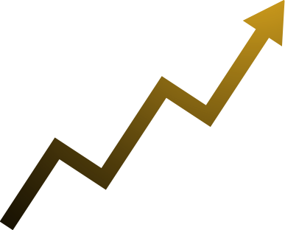
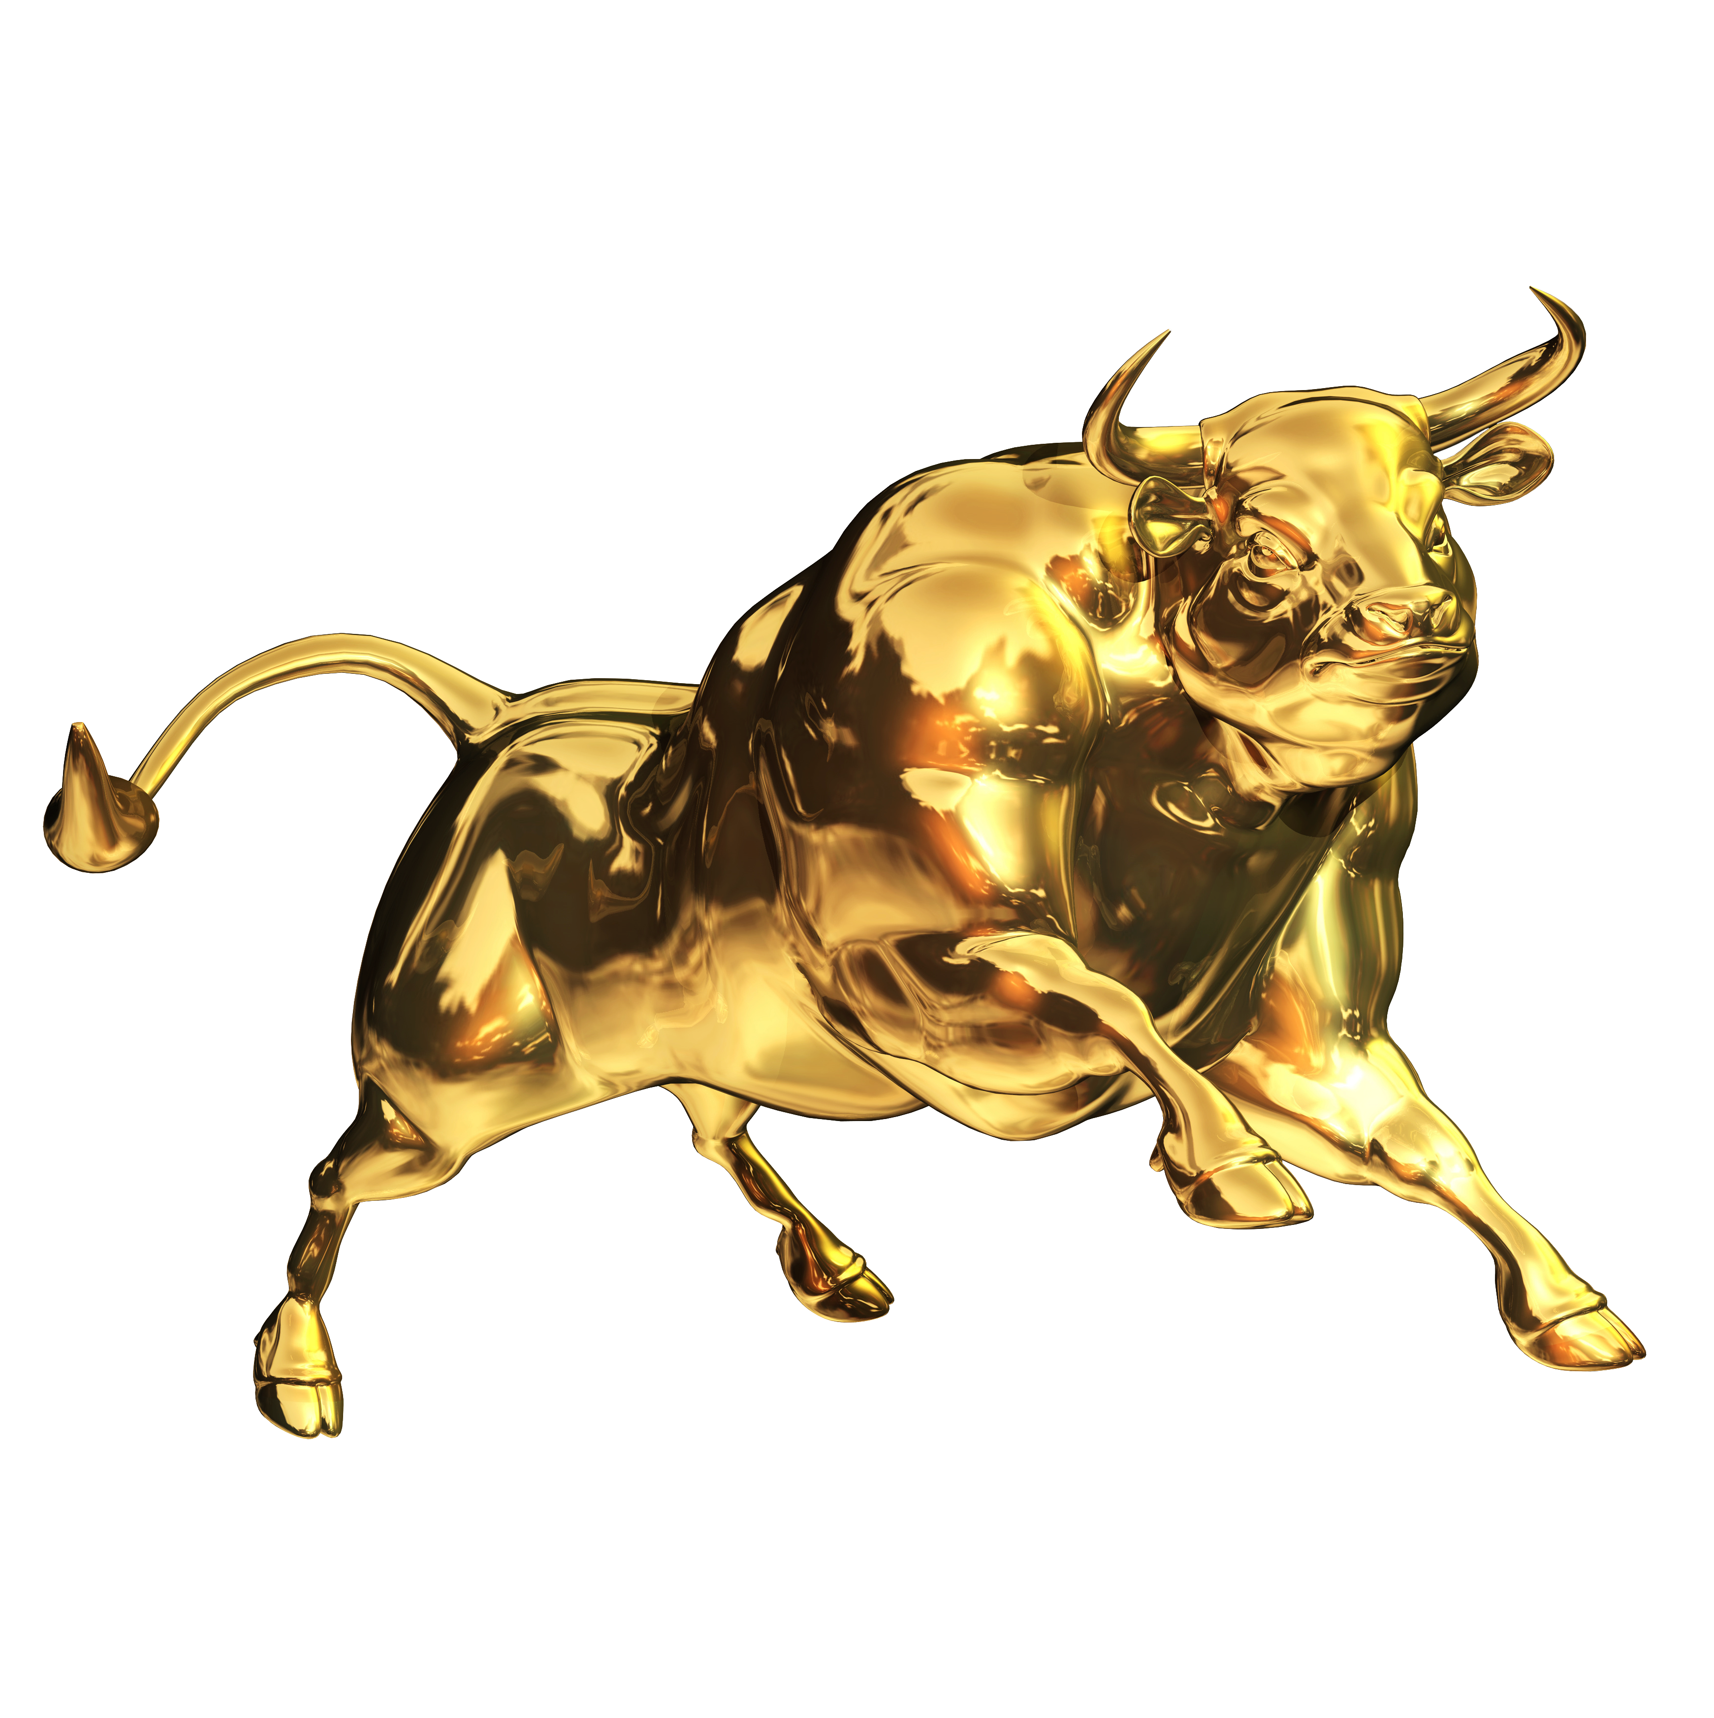
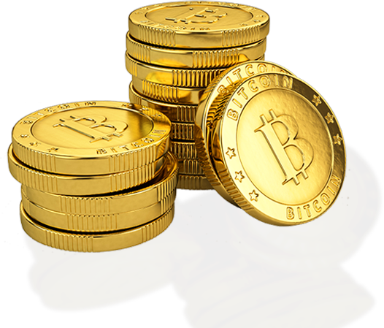
COMMUNITY
PRESENTATION
A Global NFT Group Product
March 2024
Notes:
Welcome to the Global NFT Group or GNG as we like to call it…. Community presentation

Slide 2
WELCOME TO THE LARGEST NFT & CRYPTO COMMUNITY IN THE WORLD
A Global NFT Group Product
Notes:
We are today the world’s largest NFT & Crypto community and growing, our goal is to be the first and the largest functional community in this space and change the whole dynamics of how business in community marketing is done. And we would like to invite you to be a part of our amazing journey.

Slide 3
DID YOU KNOW? THAT THE
DIGITAL ASSETS MARKET
TO 1.8 BILLION USERS IN 2030
FROM 400M USERS IN 2023
TO 1 BILLION USERS IN 2027
Sources: Gatner, Fortune, Statista and Technavio
A Global NFT Group Product
Notes:
The Digital Assets Market is the fastest growing market in the world and that makes total sense! Why, because we are going to see everything that is in the traditional market move onto the digital market driven by blockchain technology and this will reflect in the increase of digital users by many fold over the coming years.
If we look at how the world has changed due to the drive of technology, this landscape has seen a massive shift over the last years and will see a greater shift now and into the future. Currently there are around 400 Million users in the digital assets market
Click
and research shows this will grow to 1 billion users by 2027
Click
And a staggering 1.8 billion users by 2030,
which is a massive rise in active users and a true opportunity to take advantage of this growth,……… as people will be actively looking to get engaged.

Slide 4
DID YOU KNOW? THAT THE
NFT MARKET
147 BILLION IN 2026
1 TRILLION $ IN 2030
27 BILLION MARKET CAP IN 2023
Sources: Gatner, Fortune, Statista and Technavio
A Global NFT Group Product
Notes:
The other great technological market growth as predicted by experts will be the growth in the rising NFT (non fungible token) Market set to grow from it’s current 27 Billion market cap
Click
To 147 Billion in 2026, that’s a 600% rise in a couple of years.
Click
And a Booming 1 Trillion dollar industry by 2030, this will mark not only huge upside, but also huge opportunity in a rising market, and we are set to ride this wave in growth for many years to come!

Slide 5
IF YOU BELIEVE? LIKE US AND EXPERTS IN THIS INDUSTRY
NFT MARKET & CRYPTOCURRENCY
DO YOU BELIEVE
THE SAME AS US & MOST EXPERTS
THEN GNG IS THE ONLY PLACE TO BE
A Global NFT Group Product
Notes:
So, if you believe in the NFT and Crypto market
Click
Like we do and many experts in this space
Click
Then GNG is the only place to be, where everyday people will have the opportunity to be a part of the massive growth in this rising market in the most simple and effective way!

Slide 6
GLOBAL NFT GROUP (GNG)
A STRONG COMMUNITY BACKED BY IT’S OWN TOKEN
LET’S CATCH THE TRENDS TOGETHER
Trend #1: A rise in the NFT market by 600% over the next three to five years
Trend #2: A rise in the digital assets market to over a billion active users by 2030
Trend #3: A token structured as an index fund is possibly the most secure financial instrument to create wealth.
So, we have brought together these 3 trends in one amazing opportunity for everyday people like you!
Community Building + A Rise in NFT Market + A Rise in Digital Assets Use Case these combined with an Index Linked Fund TOKEN = GNG
There are the trends that we believe will create immense wealth over the next coming years supported by extensive external research, and if like us you believe, then GNG is the best opportunity in the market today.
A Global NFT Group Product
Notes:
Read Slide

Slide 7
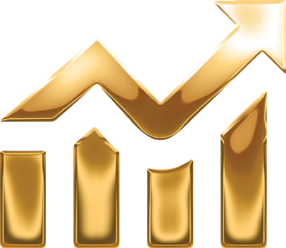
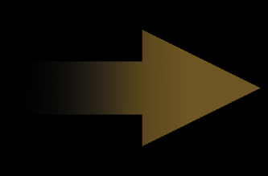
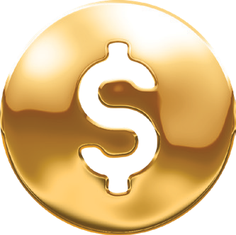
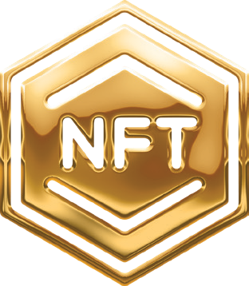
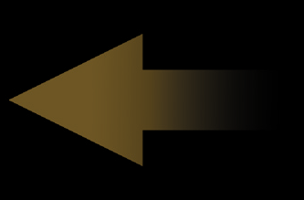
GLOBAL NFT GROUP’S
UNIQUE SELLING POINTS
”With GNG you can enter, earn and learn all in one place as we have developed a hybrid business model that has never been done before that makes business sense and creates long term sustainability“
THE PERFECT SYNERGY MODEL
A Global NFT Group Product
Notes:
GNG has many unique selling points the key ones are, that we will ride the wave of growth together in these tech markets set to rise by 600% and more over the coming years,
we are building a one time happy and functional community that will benefit from this growth,
our product is a brand building NFT that is sellable across all global markets,
we offer the best income earning opportunity in the market today and these elements are all backed by our own security token that will create long term wealth for our community for many years to come.
Read slide

Slide 8
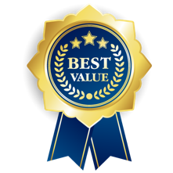
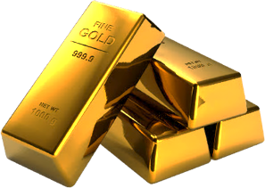
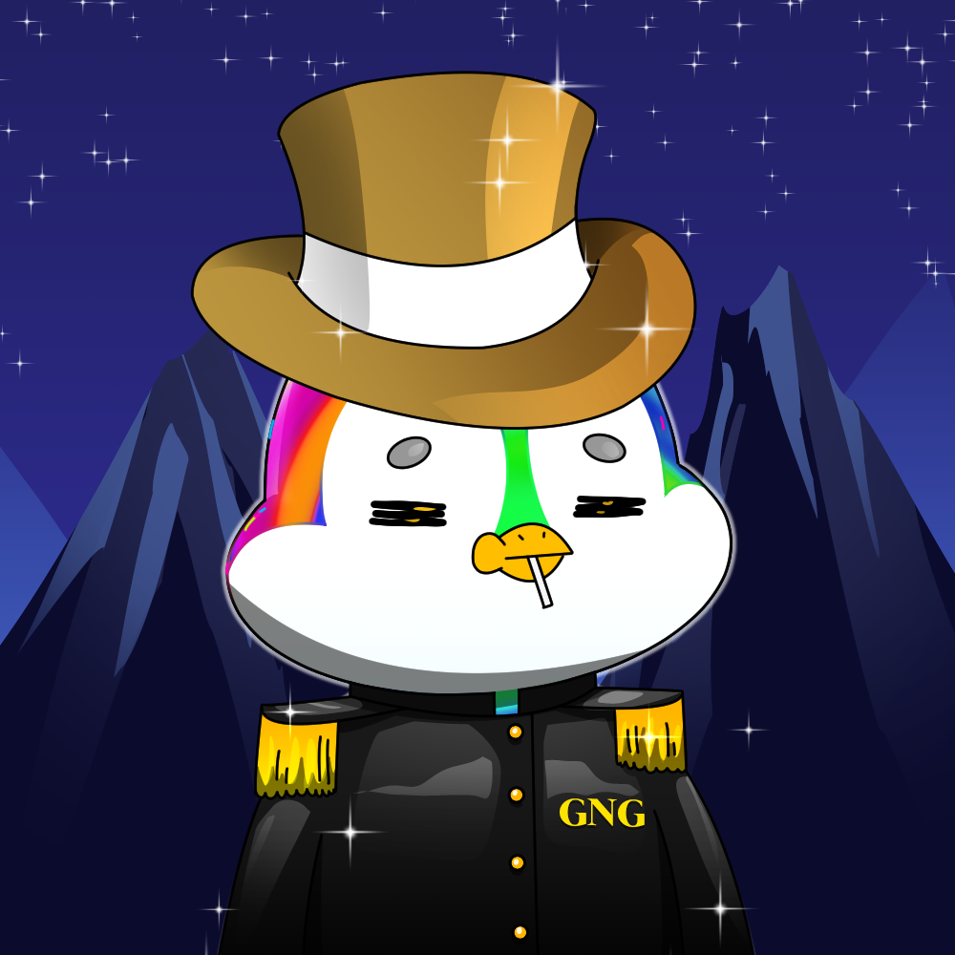
THIS IS HOW IT WORKS
AND THESE ARE THE BENEFITS
AND RECEIVE
BUY
OUR BRAND BUILDING
NFTs
Community Rewards
For Community
Marketing Members
Gifted PNGVN Tokens
for the Whole Amount that
pay Quarterly Dividends
PRICE RANGE FROM $250 - $3 900
Education classes in NFT & CRYPTO
Masterclasses in FINANCE
A Global NFT Group Product
Notes:
This is how it works and the benefits you receive being a part of the GNG Community and it’s so SIMPLE.
Click
When You buy one of our brand building NFTs, you become a community member and this opens up the whole GNG opportunity to you:
Our NFT’s range from $250 to $3,9000
Buy an NFT and
Click
WE will gift you our own PNGVN tokens for the full amount that pay out quarterly dividends,
Click
When you become a community marketing member and invite 2, this allows you to earn from the best COMMUNITY REWARDS and pay outs ever.
Click
As a community member, you will have access to the best information in the NFT and Crypto space
Click
and the best masterclasses in Finance.
You receive All of these benefits just by buying our brand building NFT, making this the easiest way to enter and earn from the NFT space.
Our business opportunity is Simple, inclusive and most importantly straightforward.

Slide 9
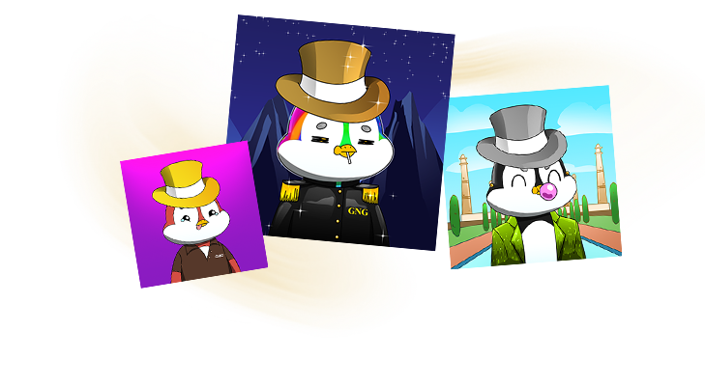
OUR BRAND BUILDING NFT’S WHY THE SOPHISTICATED PENGUIN
DID YOU KNOW?
That the penguin is the most social of all species on earth
That they live in large groups (or communities) their whole lives
That when they work (hunt) they work in groups from 5 – 20
That is why we are proud to have the sophisticated penguin as the creative brand identity of the GNG Community
A Global NFT Group Product
Notes:
Let’s talk about our product and why we chose the sophisticated Penguin to build our brand identity for the community and token.
For us it’s all about the collective identity of the community and company working together in perfect synergy. Where we work together, where all are equal with the same opportunities and we have a single common goal. That is why we chose the sophisticated penguin as our Brand identity for our NFT collections. The best part is that every NFT has been created by a digital artist using real art techniques and every NFT is unique, so you are buying a one off piece.
Click
Did You Know:
Click: Read
Click: Read
Click: Read. Click: Read.
With this brand and ethos, together with our community and PNGVN Token we are well on our way to building a new era in community marketing, making community growing great again!

Slide 10
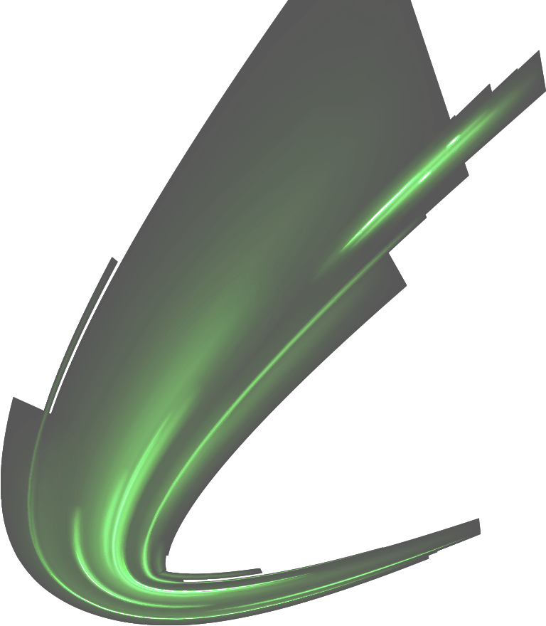
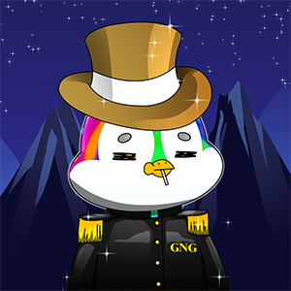
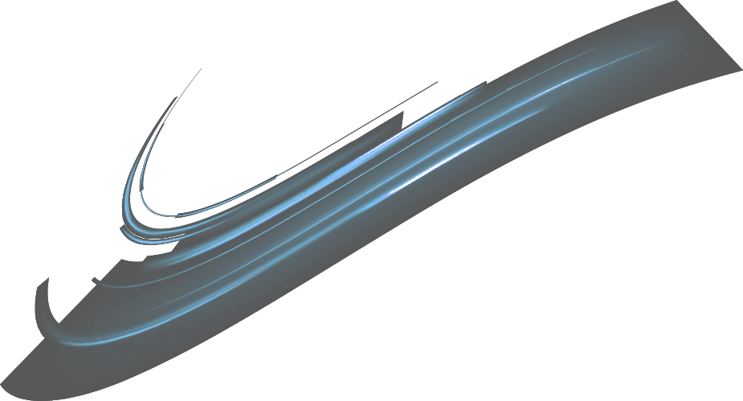
OUR BRAND BUILDING NFT’S COLLECT ONE, TWO… OR COLLECT THEM ALL
$250
5 Levels
Gifted PNGVN Tokens
for $250
$500
6 Levels
Gifted PNGVN Tokens
for $500
$1 000
7 Levels
Gifted PNGVN Tokens
for $1 000
$2 000
8 Levels
Gifted PNGVN
Tokens
for $2 000
A Global NFT Group Product
Notes:
With Our Brand Building NFTs, we want you to collect them all,………… and to secure the maximum number of gifted PNGVN tokens at the lowest price, before listing!
Our single NFT’s start from 250 dollars up to two thousad dollars.
Click
The green hat NFT is 250$, you recieve an exclusive limited edition nft, 5 levels in community rewards and 250$ worth of gifted PNGVN tokens.
Click
The blue hat NFT is 500$ with an exclusive limited edition nft, 6 levels in community rewards and 500$ worth of gifted PNGVN tokens.
Click
We then have the sliver hat NFT at 1000$ with an exclusive limited edition nft, 7 levels in community rewards and 1000$ worth of gifted PNGVN tokens
and finally…………
Click
Our Gold hat NFT at 2000$, with an exclusive limited edition nft, the maximum 8 levels in community rewards and 2,000$ worth of gifted PNGVN tokens.
The number of gifted tokens distrubuted decreases as the community grows, as we have a fixed number of tokens that will be distributed to the community through the sale of our brand building NFT’s.
Our product line is exclusive, exciting and affordable and the only product in the NFT space that opens you up to multiple earning opportunities.

Slide 11
BUILD ON BUNDLES FOR THE BEST RESULTS ONLY AVAILABLE ON REGISTRATION
GREEN BUNDLE $400 Perfect Starter
Unlocks all levels
5% Extra gifted PNGVN Tokens
BLUE BUNDLE $900 For Growth
Unlocks all levels
10% Extra gifted PNGVN Tokens
SILVER BUNDLE $1 900 For Leaders
Unlocks all levels
15% Extra gifted PNGVN Tokens
GOLD BUNDLE $3 900 For Entrepreneurs
Unlocks all levels
20% Extra gifted PNGVN Tokens
A Global NFT Group Product
Notes:
And if you like what you see so far, and see the opportunities that are availalble, you can collect our NFTs in bundles and build your community on bundles for the best possible results, available only on registration.
The Green (perfect starter) bundle, for $400 gives you 3 NFTs in our collection, opens up all 8 community reward levels and an extra 5% gifted tokens.
Click
The Blue (Growth) bundle, for $900 gives you 4 NFTs in our collection, opens all 8 community reward levels and an extra 10% gifted tokens.
Click
The Silver (Leader) bundle, for $1,900 gives you 5 NFTs in our collection, opens all 8 community reward levels and an extra 15% gifted tokens. And
Click
The Gold(Entrepreneur) bundle for $3,900 gives you all 6 NFTs in our collection, unlocks all 8 community reward levels with an amazing 20% extra gifted tokens.
The bundles give more value and the one time opportunity on registration to be gifted extra PNGVN tokens BACK TO YOU!

Slide 12
OUR BRAND BUILDING NFT’S INCLUDED EXCLUSIVELY WHEN YOU BUY A BUNDLE
Bonus NFT
When you buy any
Bundle
Bonus NFT
When you buy any
Bundle
A Global NFT Group Product
Notes:
With you buy any bundle you receive 2 bonus NFTs from our collection.

Slide 13
SIMPLE SYSTEM WITH OUR MONTHLY NFT OPTION: NEWS WAYS FOR BETTER WORKING
AND RECEIVE
BUY 1 NFT
MONTHLY
Gifted PNGVN Tokens
for the Whole Amount
UPGRADE NFT
$400
A Global NFT Group Product
Notes:
Also, you have the option to purchase our monthly upgrade NFT for better ways of working.
CLICK
With our monthly upgrade NFT you receive a brand building NFT, 8 levels in community rewards and gifted PNGVN tokens for the whole amount.
CLICK
This means that you are able to earn reoccurring commissions every 30 days, making the GNG business opportunity sustainable for the long run, so you will not need to look for any other opportunity to earn money from, in the future.

Slide 14
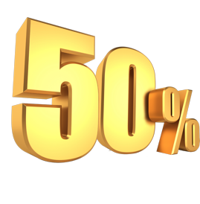
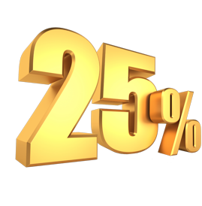
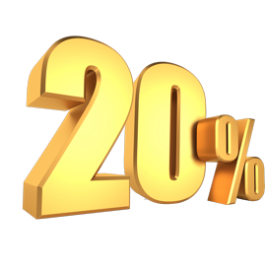
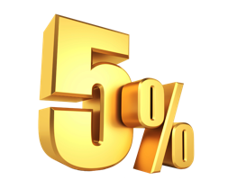
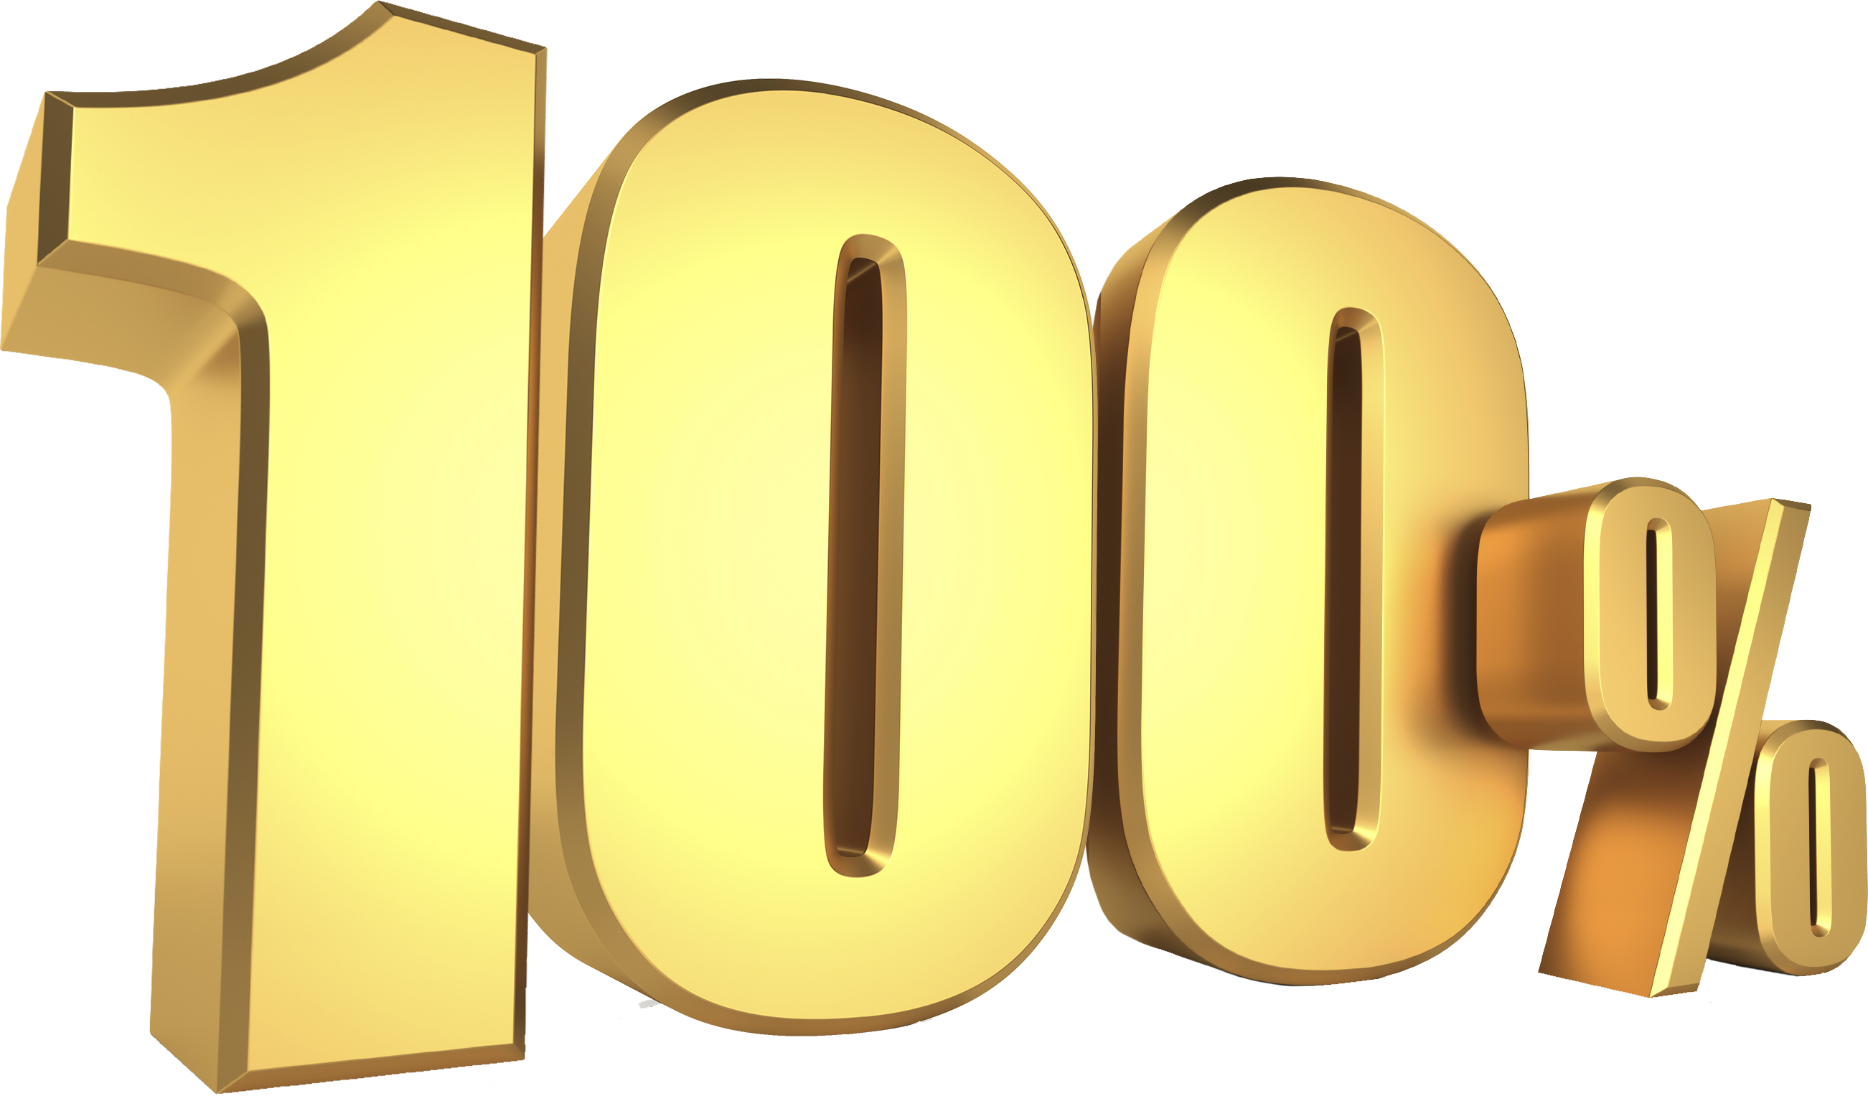
IT’S ALL IN THE NUMBER’S AND THE NUMBER’S ARE IN YOUR FAVOUR
+
+
+
=
NOTHING MORE NOTHING LESS
These are the numbers we are audited against
When you understand the logic and transparency behind these numbers you have found your new community
A Global NFT Group Product
Notes:
Because for us as a company, It’s all in the numbers and the numbers are in YOUR favour.
We only have 100% at our disposal
READ SLIDE
50% is paid out in community rewards
25% is invested in the rising market through our index
20% is set aside for dividends every quarter after listing the PNGVN token
And 5% goes to the company to cover running costs.

Slide 15
EQUAL AND FAIR EARNING POTENTIAL THE MOST REWARDING BONUS PLAN FOR ALL
Our community building rewards are easy, fair and most importantly where all are equally rewarded.
It is a simple system of duplication and you are rewarded every time, any person, in your community makes a purchase of one of our brand building NFTs.
This is why community building is the most effective way of building a happy and functional community.
We pay out a total of 38% on a community of 510 people and 12% of the total revenue from the sales of our brand building NFT’s goes into 2 Leader pools, 6% each, which you are entailed to once you complete the rank criteria.
This is a great way to earn from our system.
Level
1
2
2+10%
2
4
5%
3
8
5%
4
16
5%
5
32
5%
6
64
2%
7
128
2%
8
256
2%
Total:
510
28% + 10% +12% = 50%*
A Global NFT Group Product
Notes:
50% of the total revenue from the sale of our brand building NFTs goes back to the community as community rewards. Making our community rewards the most fair and rewarding bonus plan.
Read Slide

Slide 16
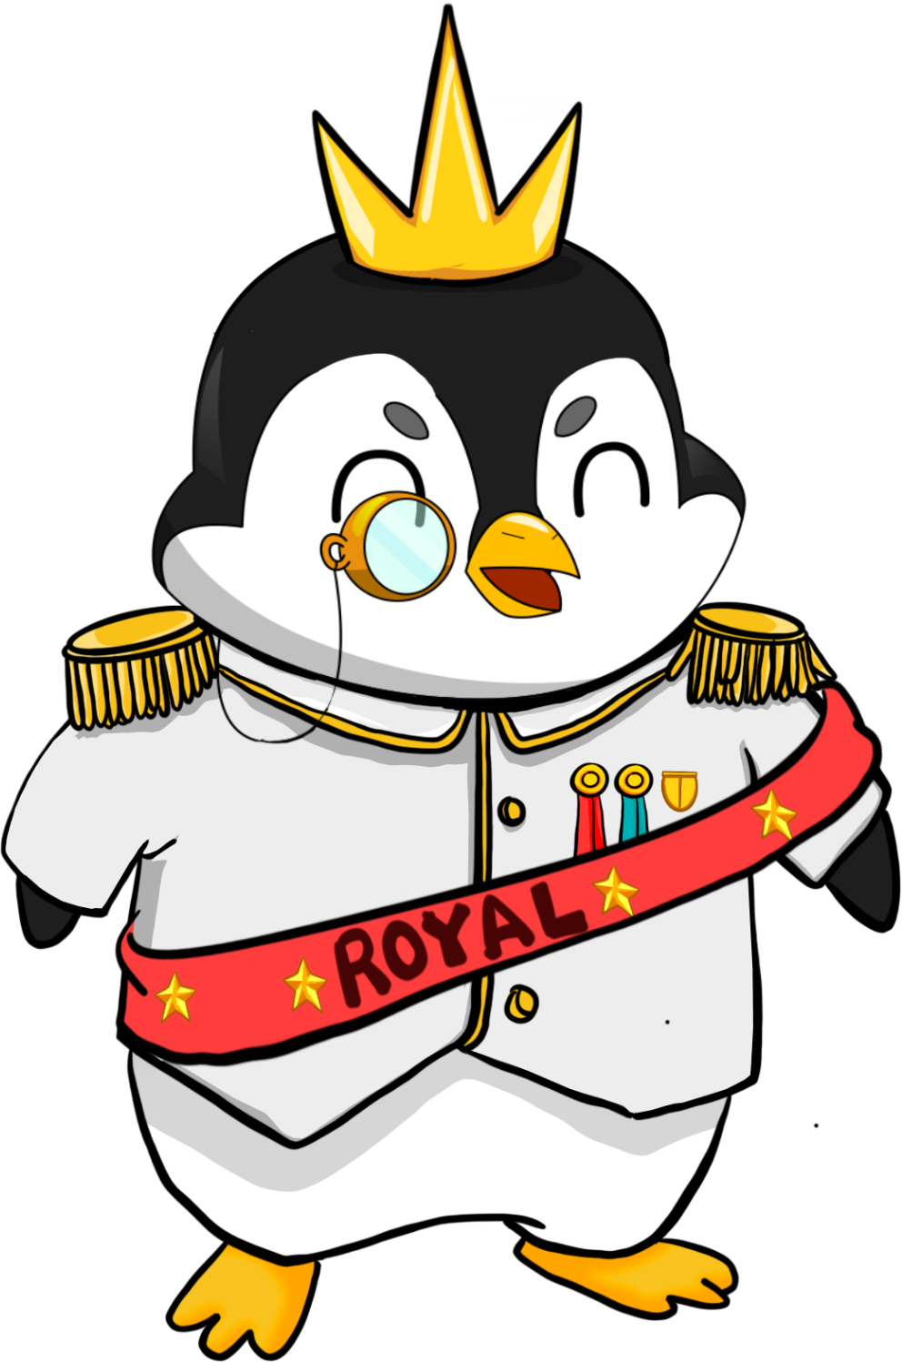
EQUAL & FAIR EARNING POTENTIAL
LEADER REWARD: ROYAL PENGUIN
QUALIFICATION REQUIREMENTS
Active member
Minimum 30 in the Matrix (Full 4 Levels)
Minimum $10 000 in turnover*
*Monthly
6%
OF TOTAL TURNOVER
A Global FT Group Product
Notes:
For those who are interested to be leaders and go above and beyond to help others to earn and build strong teams and a functional community we have two ranks or leader recognition rewards.
The first is Royal Penguin, in order to qualify you need to be an active member
Click
Have a minimum of 30 people in your matrix that is 4 full levels
And a minimum of $10,000 in monthly Turnover in your total community
Click and when you achieve this you will be recognised as a Royal Penguin and be eligible for 6% in rewards of the total community turnover.
This will be a massive payout on top of the community building rewards down to 4 levels.

Slide 17
GNG FOUNDATION ROYAL PENGUIN RANK IT’S ALL ABOUT THE POWER OF 2 BUILD AND MAINTAIN TO 4 LEVELS
YOU
Perfect bundle
Referral 1
Referral 2
Perfect bundle
Perfect bundle
Referral 3
Referral 4
Referral 5
Referral 6
Perfect bundle
Perfect bundle
Perfect bundle
Perfect bundle
Referral 7
Referral 8
Referral 9
Referral 10
Referral 11
Referral 12
Referral 13
Referral 14
Perfect bundle
Perfect bundle
Perfect bundle
Perfect bundle
Perfect bundle
Perfect bundle
Perfect bundle
Perfect bundle
Referral 24
Referral 30
Referral 25
Referral 28
Referral 18
Referral 22
Referral 23
Referral 26
Referral 29
Referral 16
Referral 19
Referral 27
Referral 17
Referral 20
Referral 15
Referral 21
Perfect bundle
Perfect bundle
Perfect bundle
Perfect bundle
Perfect bundle
Perfect bundle
Perfect bundle
Perfect bundle
Perfect bundle
Perfect bundle
Perfect bundle
Perfect bundle
Perfect bundle
Perfect bundle
Perfect bundle
Perfect bundle
A Global NFT Group Product
Notes:
The best way to get off to a flying start and see fantastic rewards in a short space of time is to buy a bundle and invite 2 friends in immediately. This will be the easiest way to earn and be active in the system and then you have to make sure that your friends duplicate and it continues.
This means anyone who joins the GNG opportunity only needs to find, support and work with 2 people to get the community growing and this is how the business can be easily relplicated over and over again. It takes 2 to be active in GNG and this is how we have created a smart working system that rewards a little smart work over and over again.
Keep it super simple by following the system and you will benefit from amazing results.

Slide 18
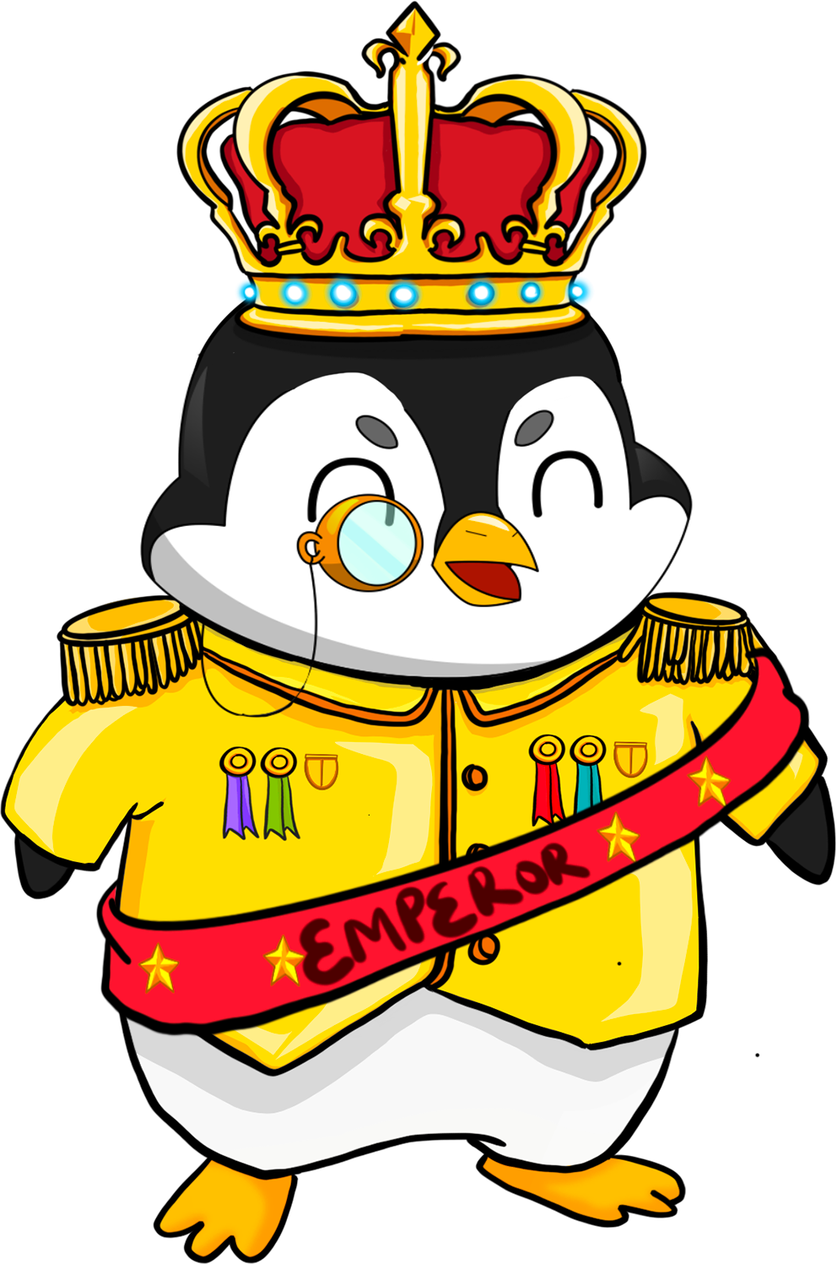
BUILDING REAL VALUE
LEADER REWARD: EMPEROR PENGUIN
6% OF TOTAL TURNOVER
QUALIFICATION REQUIREMENTS
Active member
Minimum 320 accounts in the Matrix
10 Personal invitees
Minimum $500 000 in turnover*
*$100 000 to maintain
A Global NFT Group Product
Notes:
And the second leader reward is for the Emperor Penguin Rank to qualify you have to be an active member
CLICK
Have a minimum of 320 accounts in your matrix
CLICK
Have 10 personal invitees
Click
And have a minimum $100,000 in monthly total community turnover.
You are then eligible for a further 6% of the total GNG turnover.
Those who are eligible for our Leader rewards can earn upto a massive 12 % of the total GNG turnover, we give massive rewards for community building leaders in the GNG business opportunity.

Slide 19
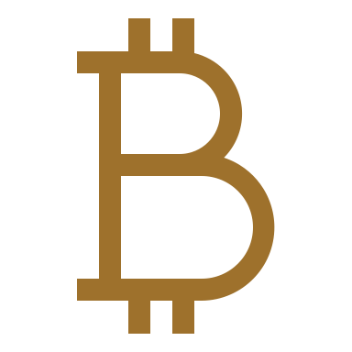
INVESTMENTS ON BEHALF OF THE COMMUNITY
THE PNGVN INDEX CONTAINS 130 COMPANIES
TOP 100
NFT
TOP 15
CRYPTO
TOP 15
AI
A Global NFT Group Product
Notes:
25% of the total revenue from the sale of our brand building NFTs is invested on behalf of the community.
We have already invested in the top 130 companies.
Our current investment portfolio is 100 investments in NFT projects, 15 in the most promising Cryptocurrencies and 15 in Artificial Intelligence projects, as these are predicted to see substantial gains in the coming years.
This is our index and this is what will create security for all in our community.

Slide 20
DIVIDEND TO BE PAID OUT QUARTERLY
A Global NFT Group Product
Notes:
20% of the total revenue from the sale of our brand building NFTs will be used to pay out quarterly dividends to PNGVN token holders once the token is listed.
That means that a massive of 95% of our total revenue goes back to our community through our business model giving us huge advantage over any other companies in this space.

Slide 21
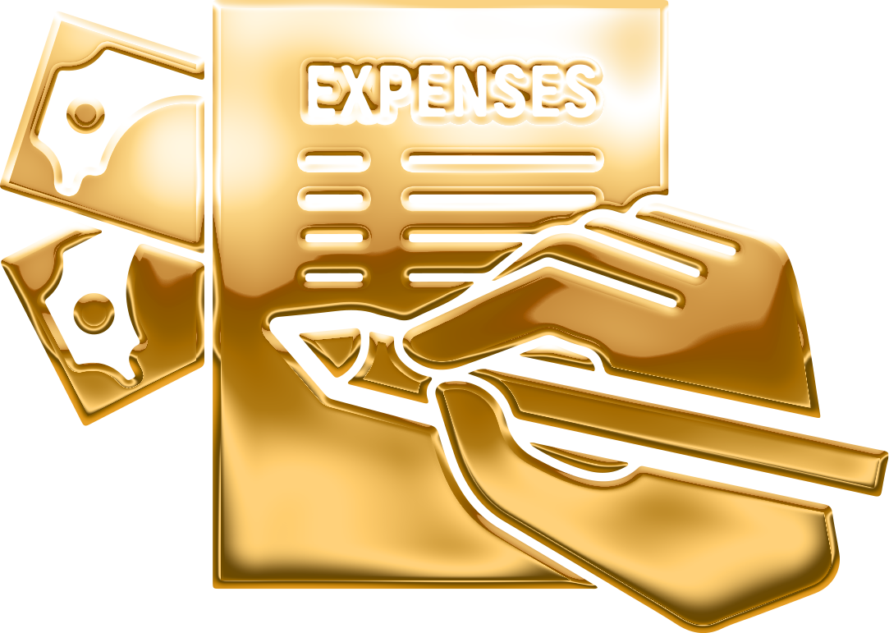
COMPANY TO COVER ON GOING COSTS
A Global NFT Group Product
Notes:
And
5% will go to the company to cover ongoing costs, this shows the belief the company has in the PNGVN Token and it’s future success……….. Showing the greatest transparency……….. EVER.
With so much of the revenue,……… going back into the business model,…….. This, is what we believe will give us, a happy and functional community who are engaged, educated, rewarded and exited, which in turn will lead to, unlimited growth and long term sustainability.

Slide 22
PNGVN TOKEN DETAILS THE BASICS BEHIND OUR TOKEN
KICK-OFF $0.10
LISTING 05.07.2024
EXCHANGE Coinstore
VOLUME 250M
LISTING PRICE $0.50
A Global NFT Group Product
Notes:
Some basic details behind our PNGVN token.
We opened at a value of 10 cents per gifted token for the full amount of the NFT purchased,
Our listing will be on the 5th July 2024
Our listing exchange will be CoinStore.
The total number of tokens is only 250 million
And we are building the community to take the token to a listing price of 50 cents, with true value through investments and quarterly dividend payouts that will act as utility behind our token.

Slide 23
OUR TOKEN DISTRIBUTION FROM $0.10 TO $0.50 LISTING GOAL
TIER | GIFTED DISTRIBUTED TOKENS | VALUE | NFT SALES VOLUME
1 | 2 000 000 | $0.10 | $200 000
2 | 2 000 000 | $0.12 | $240 000
3 | 2 000 000 | $0.14 | $280 000
4 | 2 000 000 | $0.16 | $320 000
5 | 2 000 000 | $0.18 | $360 000
6 | 4 000 000 | $0.20 | $800 000
7 | 4 000 000 | $0.22 | $880 000
8 | 4 000 000 | $0.24 | $960 000
9 | 4 000 000 | $0.26 | $1 040 000
10 | 4 000 000 | $0.28 | $1 120 000
11 | 6 000 000 | $0.30 | $1 800 000
PNGVN TOKEN
A Global NFT Group Product
Notes:
Our tokens will be distributed incrementally as we grow our community through the sale of our brand building NFTs to work towards our 50 cent listing price.
The goal is to gift our token, by building by a strong community and then list the token with real value into the open market.
The only advantage of getting in early is that you will get the greater number of tokens at the cheapest price.
When we hit the numbers at ever tier the price will go up by 2 cents as shown in the table.
The true value of the token going up will be underpinned by the investments in our index fund and the Dividends being collected to be paid out quarterly upon listing.
So, when ever you are gifted tokens, through the purchase of our brand building NFTs, you will always be buying into real value.

Slide 24
BUILD REAL VALUE EXPECTED MARKET VALUE
2024/25 $8.00 Expected market value by the end of 2024/25
2026 $37.00 Expected market value by the end of 2026
PNGVN TOKEN
A Global NFT Group Product
Notes:
We build real value through our whole business model
click
and with the expected rise in the NFT and crypto market we are looking at the value of our token to hit 8$ by the end of 2024 mid 2025
click
and 37$ by the end of 2026

Slide 25
DO-TEACH-REPEAT
IF YOU DO IT – DO IT RIGHT
A Global NFT Group Product
March 2024
Notes:
To further support the community.
We have developed a simple Do-Teach-Repeat System, Built for success
But if You do it, you have to do it right!

Slide 26
COMMUNITY IS PLURAL
NOT SINGULAR
AFTER YOU IT ONLY TAKES TWO
(TO START AND QUALIFY FOR COMMUNITY REWARDS)
ACTIVE COMMUNITY MARKETING MEMBER
(QUALIFIED FOR COMMUNITY REWARDS)
A Global NFT Group Product
Notes:
Community is Plural and Not Singular,
After you it only takes two to get active.
When you invite two people into your community you are qualified for community rewards and all the associated benefits.

Slide 27
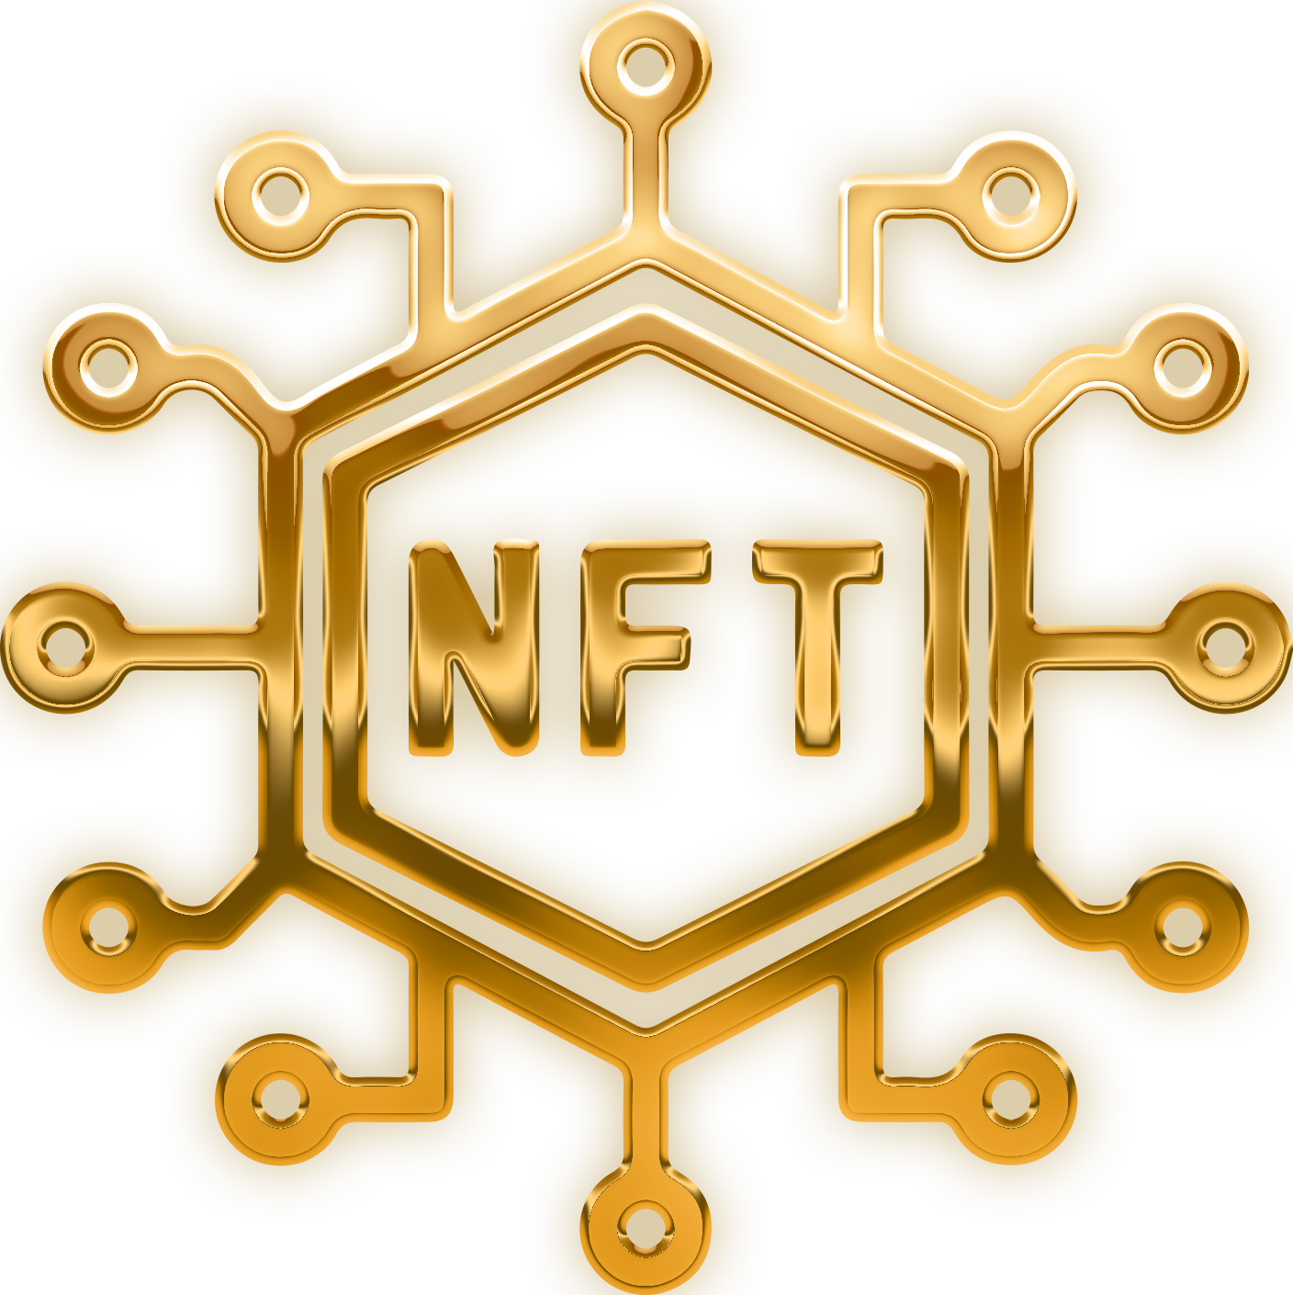
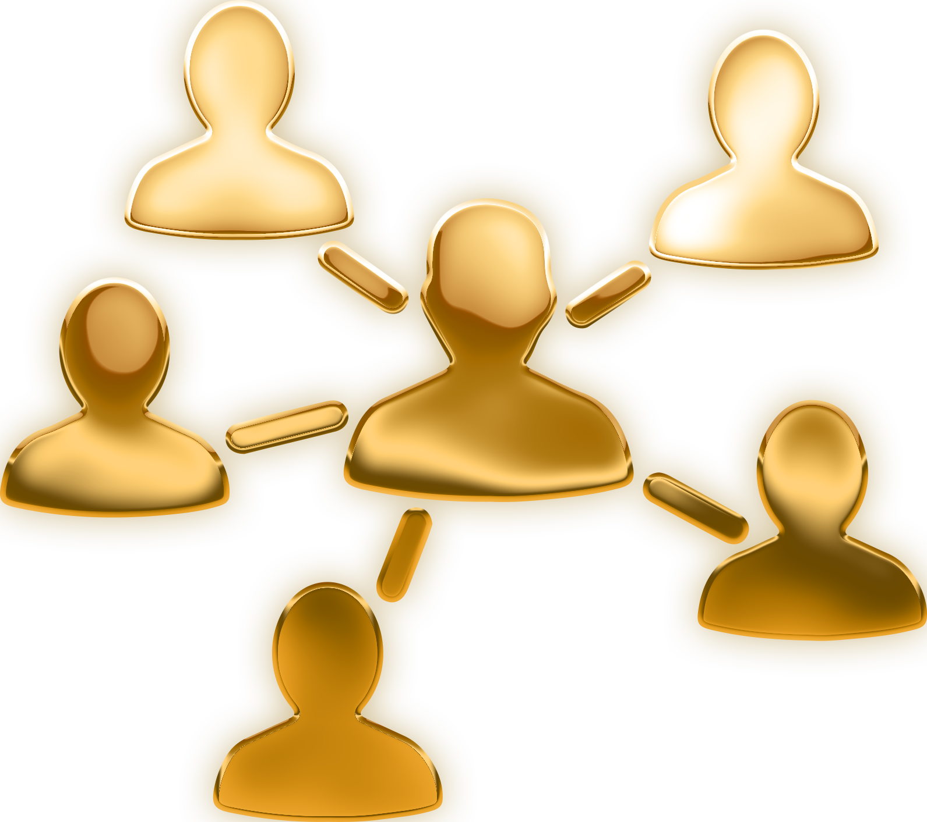
COMMUNITY REWARDS FOLLOW OUR SYSTEM TO SUCCESS: DO – TEACH - REPEAT
STEP 1 – DO
Take action
Join & start your NFT collection
STEP 2 – TEACH
Invite 2 people
And show them the way
STEP 3 – REPEAT Help your people
to do the same
A Global NFT Group Product
Notes:
The true strength of community marketing is leverage, where everyone makes a small effort and collectively this results in huge gains.
We want our community to get the maximum benefit of this business model,……… and for that you need to follow our system to success…the Do, Teach, Repeat system
Click
Step 1, Do, take Action, join and start your NFT Collection
Click
Step 2, Teach, invite 2 people and show them the way,…….and
Click
Step 3, Repeat, help your 2 to do the same
If done correctly, the Do Teach Repeat system will create a happy and functional community,…… that will be the foundation to long term success for ALL.

Slide 28
EQUAL AND FAIR EARNING POTENTIAL THE MOST REWARDING BONUS PLAN FOR ALL
2 x 8 Matrix is the most fair and easy bonus system on the market. This means that it’s only 2 people in your first level (width) and it’s 8 levels deep (depth). No ranks, no legs, nothing to balance. What you see is what you get!
A full house is only 510. With a 38% pay-out on a full matrix and 12% into a shared leaders pool across total revenue into the company, making this a very lucrative and fair bonus plan.
You can easily see how much you earn in the matrix at each level and how many people are needed on each level to complete your full house.
Level
1
2
2+10%
2
4
5%
3
8
5%
4
16
5%
5
32
5%
6
64
2%
7
128
2%
8
256
2%
Total:
510
28% + 10% +12% = 50%*
A Global NFT Group Product
Notes:
50% of the total revenue from the sale of our brand building NFTs goes back to the community as community rewards. Making our community rewards the most fair and rewarding bonus plan.
Read Slide

Slide 29
COMMUNITY REWARDS DO – TEACH – REPEAT SYSTEM
Level
GOLD BUNDLE $3 900 +20 Extra gifted PNGVN Tokens
Week 1 1
2
$156 ($390+$390)
2 + 10%
Week 2 2
4
$780
5%
Week 3 3
8
$1 560
5%
Week 4 4
16
$3 120
5%
Week 5 5
32
$6 240
5%
Week 6 6
64
$4 992
2%
Week 7 7
128
$9 984
2%
Week 8 8
256
$19 968
2%
Referral Bonus Direct 10% = $780 ($390 + $390)
Total Bonus Community = $47 580
Total Community = 510*
*entitled to Loyalty Rewards 12% of Total Revenue
A Global NFT Group Product
Notes:
This is what it looks like when you build your community with the Gold Bundle NFT collection, for $3,900 you receive 6 NFTs, gifted PNGVN tokens for the full amount plus 20% extra.
This slide shows the true power of the do-teach-repeat system for community building model.
You can see all the payouts at each level in gold on the right hand of the slide.
When you invite 2 you make a 12 % bonus, which is 10% direct referral reward and 2% community building reward a total of $936 back to you in bonuses and when ever any one joins your community you earn, in total upto 38% right down to 8 levels.
If everyone follows the Do Teach Repeat system on the gold bundle, on a full house of 510 people you can earn just under $49,000 and also qualify for the leader pools, upto a massive 12% of the total GNG revenue , but the greatness of this model means that everyone else in your community is also earning. Which makes this a fair, equal and rewarded system for all.

Slide 30
THE GOLD BUNDLE MONEY TRAIL IT’S A TEAM EFFORT SOMETHING FOR EVERYONE!
TURNOVER 8 LEVELS: $1 989 000
YOU
UPLINE: $36 894
Earn: $48 516
YOU: $48 516
TEAM: $670 410
LVL 1: $24 258(PP)
LOYALTY: $238 680
PNGVN: $497 250
LVL 2 : $12 129(PP)
DIVIDEND: $397 800
COMPANY: $99 450
LVL 3: $6 064(PP)
LVL 4: $3 032(PP)
A Global NFT Group Product
Notes:
This is the money trail for the Gold Bundle, showing the Do teach repeat system value. Every dollar that comes into GNG is accounted for and audited against.
The earnings shown for the upline, you, the team and loyalty, make up 50% of the total turnover in this matrix to 8 levels, 25% goes to the PNGVN token for investments, 20% goes to dividends on the PNGVN token and 5% to the company to cover delivery costs.
This is our transparency as a company and how the funds are allocated so you know where every dollar you spent in our opportunity is used.
And as you can see there is a huge income earning opportunity here not only for you but for all those who become a part of your team matrix in our community.

Slide 31
KEEP YOUR REWARDS ACTIVE NEW NFT EVERY 30 DAYS
$250
5 Levels
$500
6 Levels
$1 000
7 Levels
$2 000
8 Levels
A Global NFT Group Product
Notes:
To keep your REWARDS active, AND to have a re-occuring income, you need to purchase an NFT every 90 days.
The NFT you purcahse should reflect the level of growth in your matrix so that you do not miss out on any available bonuses to you.
The community members will be happy to do this, as they can make a great income from the system and would want to continue to earn REWARDS,…….. as their community grows.
This will have several advantages for the business,………. as it will provide fresh captial for investments, and growth of the token value and dividend, as well as keeping community rewards active……. giving long term sustainability to all.
So, Do the job once, do it well, and see the benefits,……….. over and over again.

Slide 32
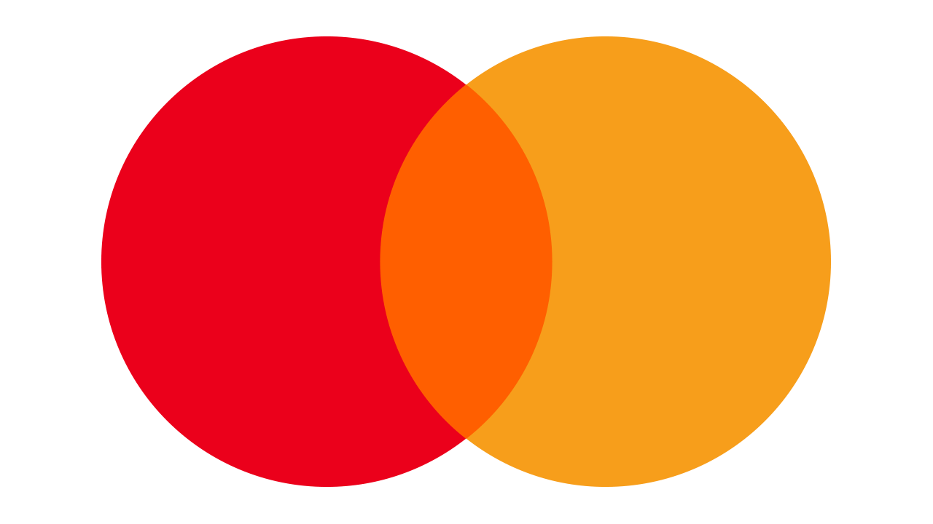
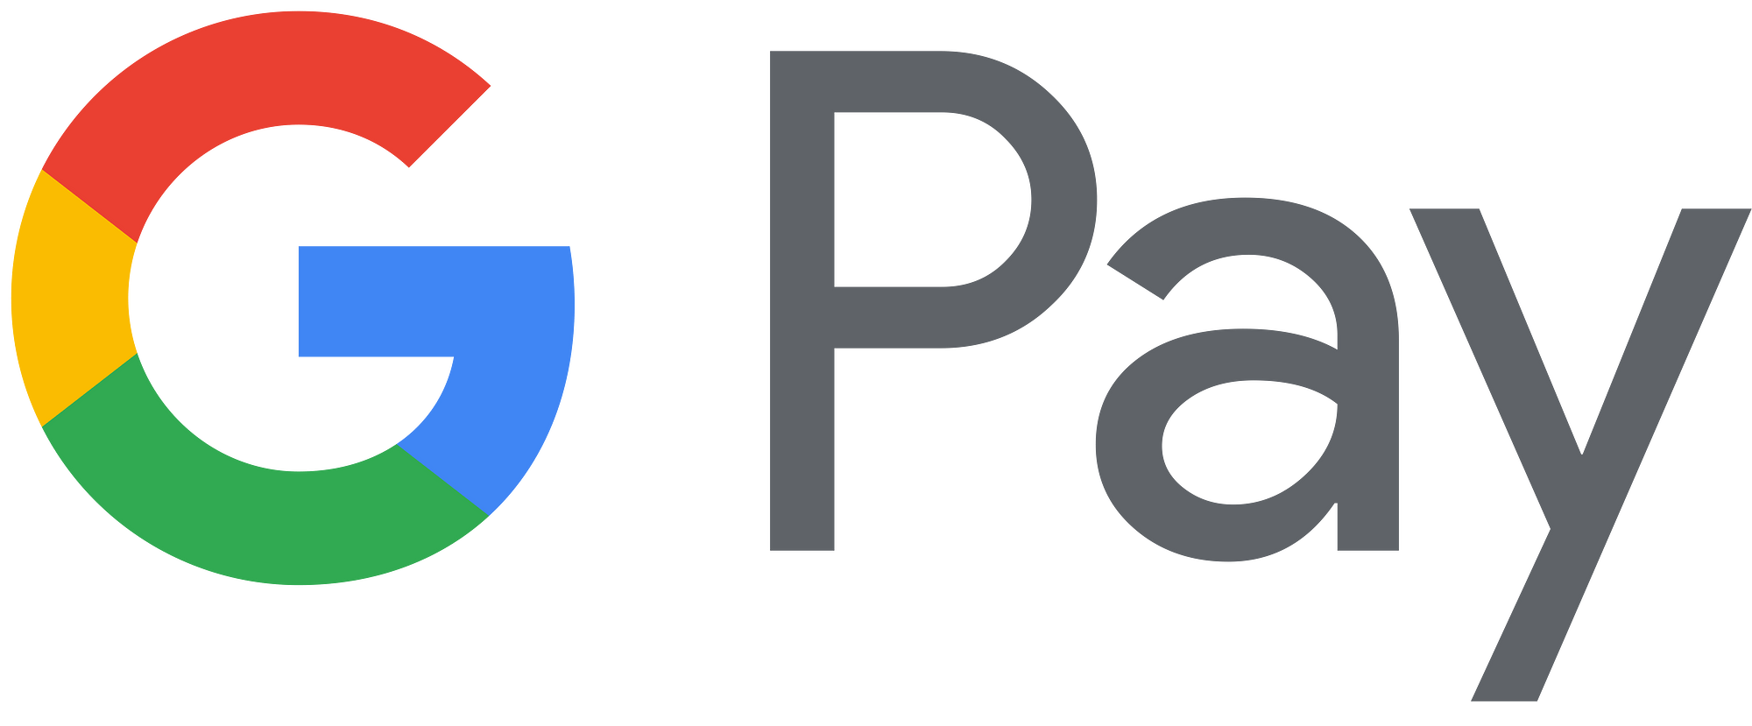
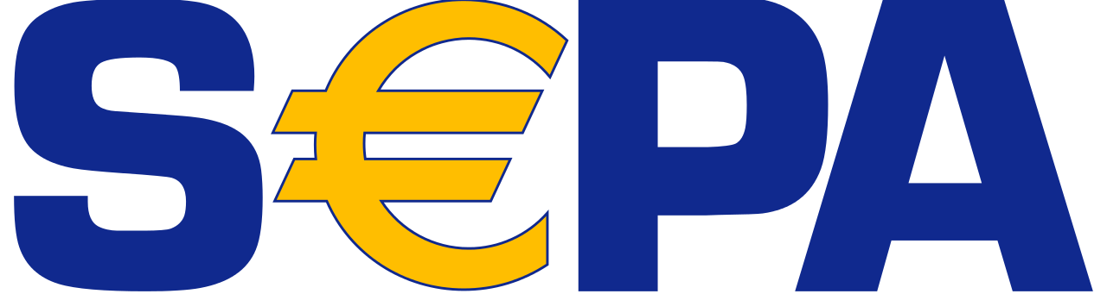
PAY-IN PAY-OUT
PAY-IN OPTIONS
PAY-OUT OPTIONS
A Global NFT Group Product
Notes:
To pay in for the GNG Opportunity we are crypto friendly and accept Tether USDT TRC20 as well as many other pay in options.
Payout of commissions will be in Tether USDT every Friday, without fail.

Slide 33
DISCLAIMER
The GNG Community sells Brand Building NFT’s (Non-Fungible Token) and community related merchandise only to individuals who can legally purchase in the particular jurisdiction that they reside.
The Brand building NFT is not refundable, but the community member is free to sell the NFT to whom ever they want on the open market.
As an appreciation, GNG Community gift the community member our own PNGVN Token. If the Community member wants, he or she can invite others into the community and are then entitled to community rewards. Invitation is optional and NOT a requirement.
If the community member invites others into the community, the member becomes entitled to community rewards. The rewards can be used to purchase new NFTS , merchandise or withdraw it as a cash payment.
This presentation is not financial advice, it solely displays the opportunity for a community if things are done correctly and in a professional manner.
Our common responsibilities are described in GNG Community’s Terms and Conditions, GDPR and Earning Disclaimer.
A Global NFT Group Product
Notes:
Read slide

Slide 34
BUILT FOR THE COMMUNITY
BY THE COMMUNITY
WHEN WILL YOU BE A PART OF IT?
A Global NFT Group Product
Notes:
The GNG opportunity is truly exciting and hugely rewarding because it has been built for the community by the community.
The only question you need to ask yourself is……WHEN WILL YOU BE A PART OF IT?

